Slide 1


FYP Final Demo & Presentation
Done by : Nicholas Ho Jun Xian (1902600)
5th August 2022
Development of power system digital twin using Raspberry PI

Slide 2
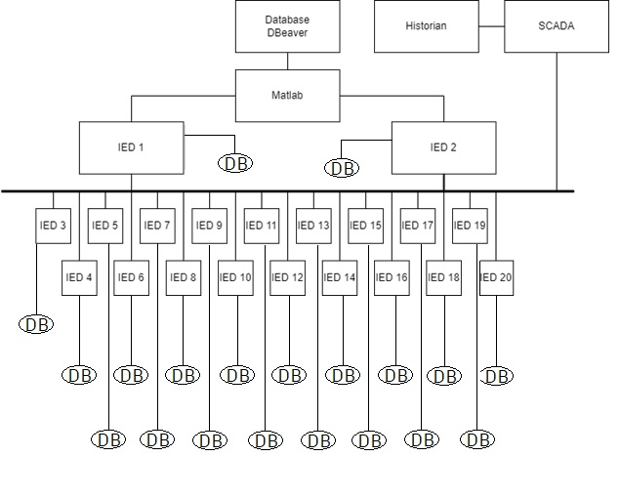
Data storage, and its importance in the project
My involvement since first demo

Slide 3
Data to be stored
Input
Voltage levels
Current levels
Voltage and current neutral
Total power
Output
Decisions made by IED
Status of circuit breakers

Slide 4
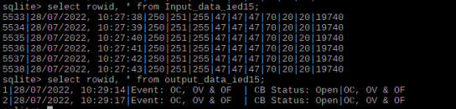
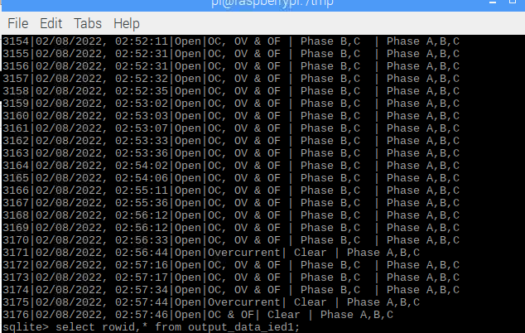
Results

Slide 5
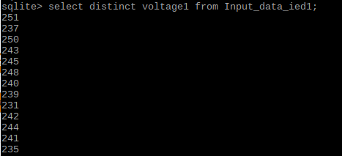
Functions of Database
Able to do quite a few functions
Update table
Delete rows or table
Select distinct statements or conditions
Allows for easy sieving and sorting of data for stats, saving time.

Slide 6
SQLite
ACID - Atomic, Consistent, Isolated, and Durable
light footprint - can run on devices such as phones, cars, and other low power or CPU applications.
Open source
Free
No server
No logins
Security flaws limited to access to device
File stored on device
Can work with a bunch of programming languages, Python, JS, C
Can be enhanced visually with visual tools

Slide 7
What is ACID?
Atomic
>Transaction takes place entirely or none, all or nothing
Isolation
>Transactions occur independently and does not cause interference
Consistency
>Transactions must be in consistent state before and after, only valid data is saved
Durability
>Written data will not be lost

Slide 8
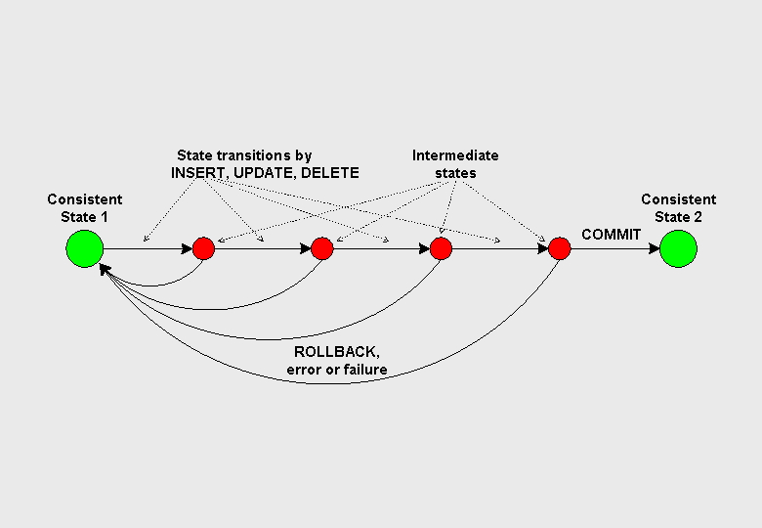
Database transaction states

Slide 9



Other databases
Have tried using other Databases,
Not free
Client Server
One platform
No guarantee of ACID

Slide 10
Cons of SQLite
Because they are contained in files, there is no server required to hold the data. This also means that the database is specific to the project, as the file is accessed in project’s directory.
However, SQLite does have its issues. For example, multiple users needing write access to the SQLite database would cause issues.

Slide 11
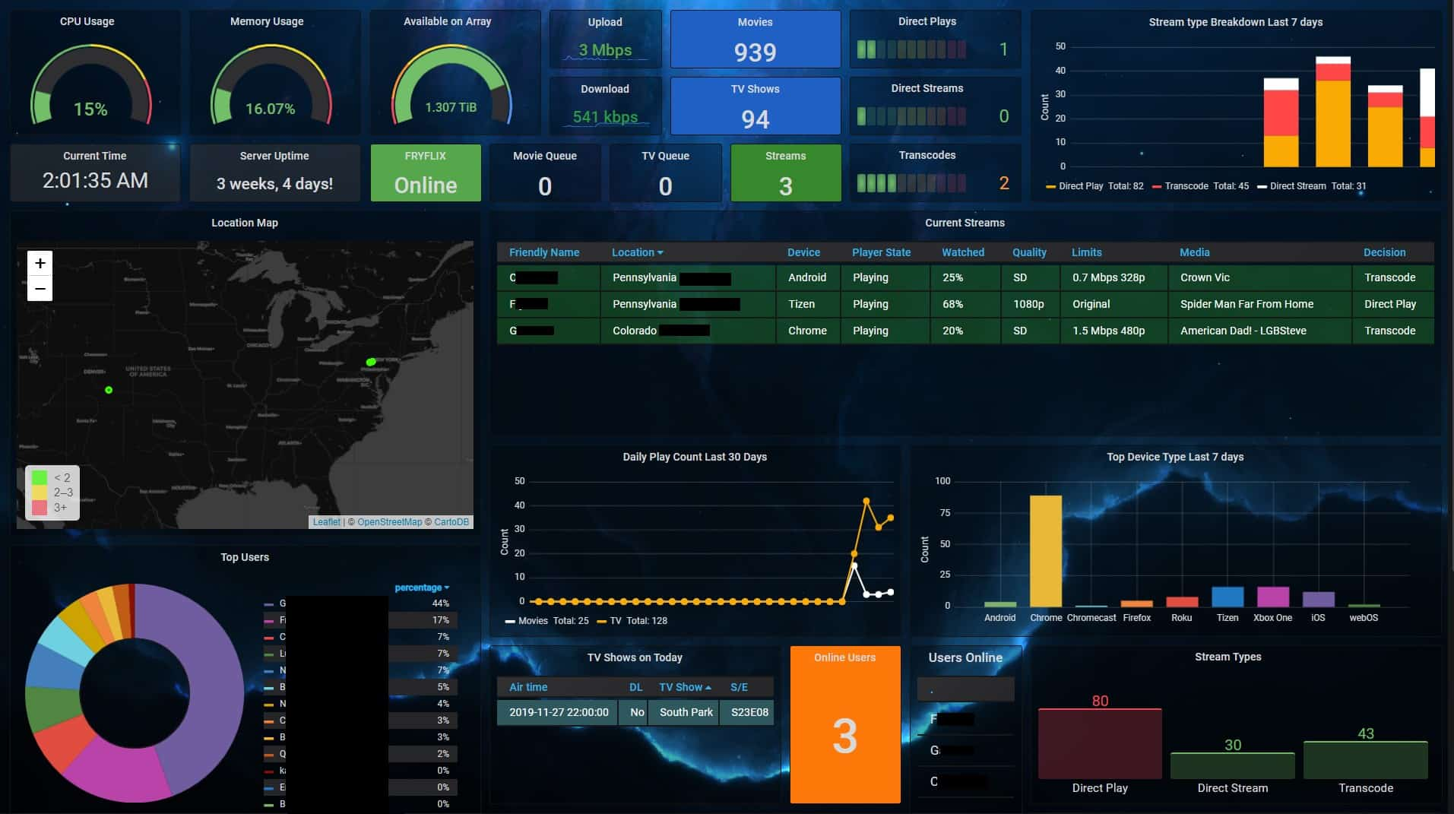
Future Works
Integration with visual graphic tools
Embed in website

Slide 12


